Slide 1
Brazilian Social Entrepreneurship with a Chicago Flavor
04-Ago-14
dr.consulta/ Thomaz Srougi

Slide 2
Non expected outcome. It’s a non expected outcome. It’s a problem.
Fact
Cause
Deviation’s root cause(s).
Upon cause to neutralize deviation.
Action

Slide 3
Fact
There is Limited Healthcare Access in Brazil

Slide 4
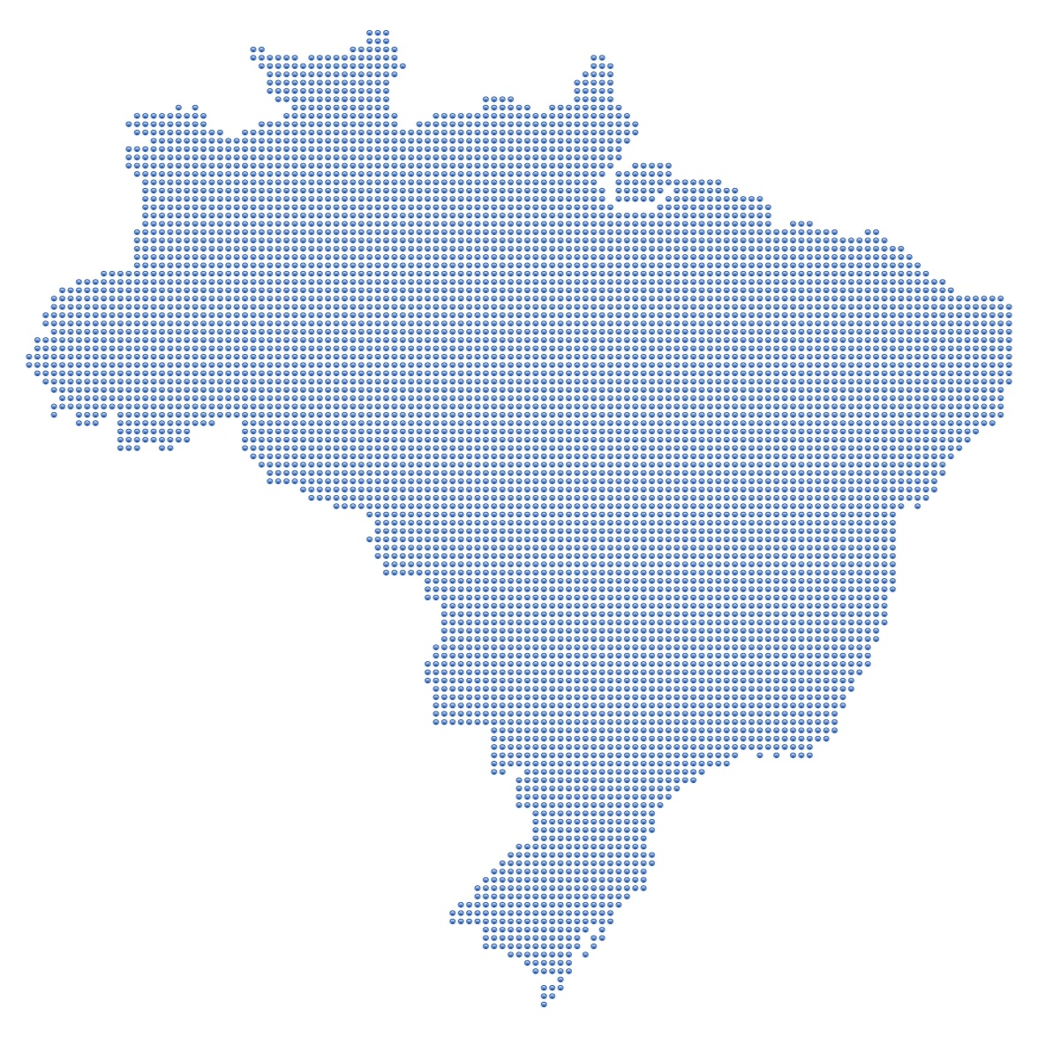
Demand for SUS Medical Visits (million)
Growing demand for basic care as population ages
Fonte: Banco da Saude Brasil

Slide 5
Supply of Medical Visits by SUS (million) Growing supply of medical visits
Fonte: Portal da Saude, DATASUS

Slide 6
Annual Deficit of Medical Visits at SUS
Causing a growing deficit estimated at 800million p.y
Fonte: dr.consulta

Slide 7
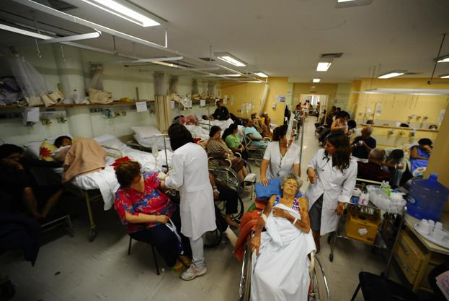
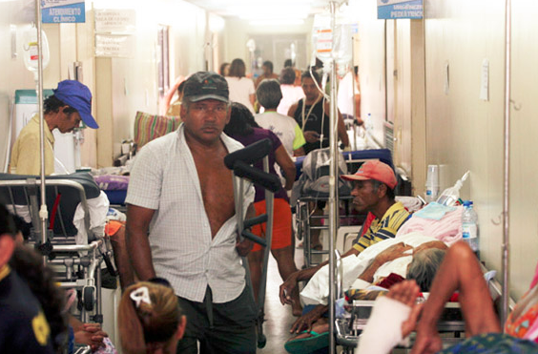
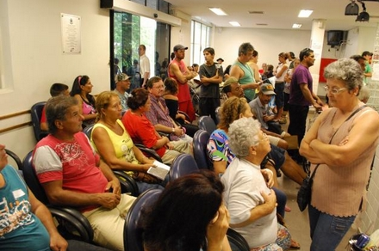
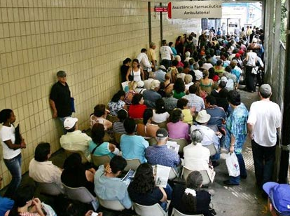

Slide 8
Cause
There is no adequate Supply

Slide 9
8 out of 10 Brazilians are Uninsured...
...and have to rely on SUS for medical care
Do you have Health Insurance?
76% NO
Fonte: ANS (Agência Nacional de Saúde)

Slide 10
But SUS is Low Quality
7 out of 10 Brazilians ranks the public system as bad or very bad
30% SATISFACTORY
How do you rank healthcare at SUS ?
70% BAD or VERY BAD
Fonte: Folha de São Paulo e IBOPE.

Slide 11
And SUS is Lengthy
It takes up to 12 months for a diagnosis from SUS
2 days
90 days
90 days
90 days
90 days
Start
Schedulling
First Visit
Exams
Return Visit
Third Visit (Specialist)
END
362 days
Fonte: Folha de São Paulo e IBOPE.

Slide 12
Also SUS lacks Adequate Structure
40% of all medical equipment is under SUS that have to attend 80% of the population
24% YES
40% PUBLIC
Ownership Healthcare Equipment
Do you have Health Insurance?
60% PRIVATE
76% NO
Fonte: Folha de São Paulo e IBOPE.

Slide 13
Because there is not enough investment
SUS invests 70% less than the private Healthcare system per person per year, but needs to attend 200% more than the private sector (in USD)
Fonte: Em 2011, Banco Mundial. World Development Indicators e ANS (Agencia Nacional de Saude).

Slide 14
Action
Governments and NGOs have failed to solve at scale. They can only provide incremental benefits
There is not enough tax revenues
There is not enough philanthropy

Slide 15
Action
It’s a resource problem, mainly.
Q: So where are the resources?

Slide 16
Action
A: They are in Businesses.
Business generates resources when it meets needs, at a PROFIT. (Michael Porter)

Slide 17
Action
PROFITS allows for a solution to infinitely scale with agility WITHOUT HAVING TO RELY ON PUBLIC FUNDS OR DONATIONS.

Slide 18
Action
So with that in mind I’ve founded dr.consulta.
We are providing solutions to a massive social problem, and using profits as means to scale rapidly.

Slide 19
Action
So that every time we meet a need, resolve a patients problem at a profit, we can offer the solution to more.

Slide 20
Rationale
High Impact
Replicable
Scalable
Profitable
Huge Market

Slide 21
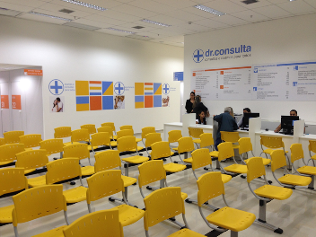
Mission & Vision
Our mission is to offer access, dignity and provide agility in basic healthcare solutions, for the base of the pyramid, inspiring others to do the same.
Our vision is in 5 years, to resolve 10million basic healthcare problems, delivering an attractive EBITDA margin.

Slide 22
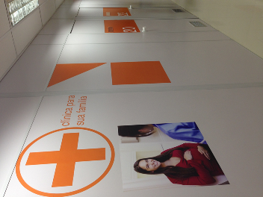
Value Proposition
To offer agile, affordable and warm hearted visits and exams, for uninsured low income families who don't want to rely on SUS anymore.

Slide 23
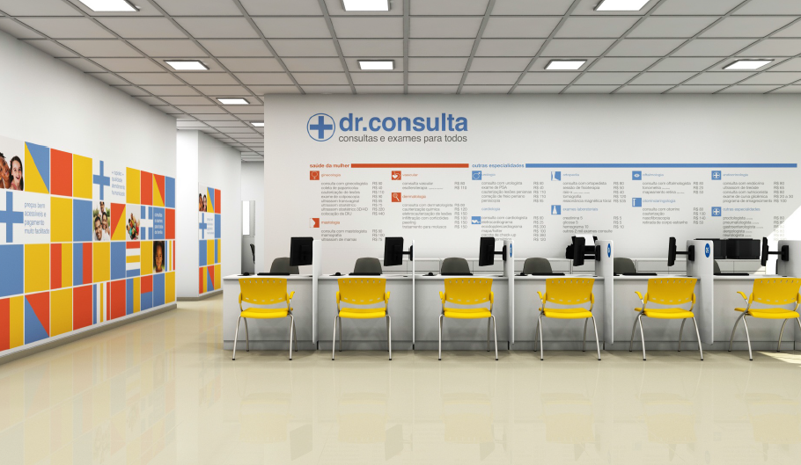
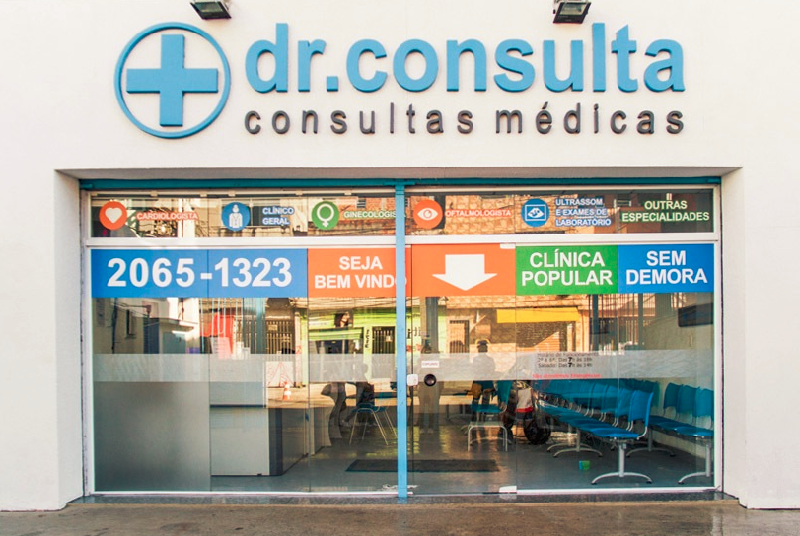
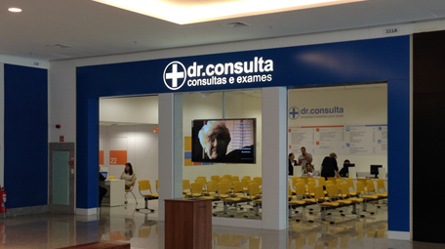
The Clinic
New Improved Version
Old Version
Heliopolis, largest favela of Sao Paulo, 200,000 people.
Shopping Plaza Sao Bernado and next ones

Slide 24
Service Dimensions
Agile
Very Affordable
High Quality
Decisive
Warm hearted
Innovative

Slide 25
Competitive Advantages
dr.consulta
Very affordable prices
Warm hearted service
Best doctors and equipments
Mgmt decisions: maximize Cost/Quality ratio.
Agile decisions based on data and facts
IT as massive tool to service more and better

Slide 26
Performance
Total Patients Served/ Semester
Total Visits Performed/ Semester
Mix %
100+ doctors & 21 medical specialties
75.000 patients attended
64,000 diagnostics delivered on average on 15 days, against 362 days at SUS.

Slide 27
Action Plan
1
2
3
4
5
Concept?
Demand?
Profitable?
Standartization
Expansion
OK
OK
OK
75%
5%
Pilot Test Phase
Replicate and Scale

Slide 28
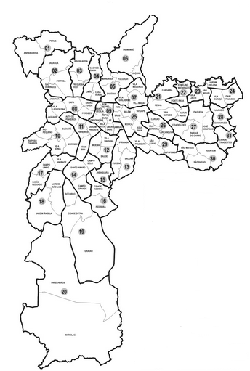
Scale
Past 3 Years
Sep 2014
Sep 2015
1 Clinic
5 Clinics
20 Clinics

